Slide 1
POLYGENIC RISK SCORE CALCULATION

Slide 2
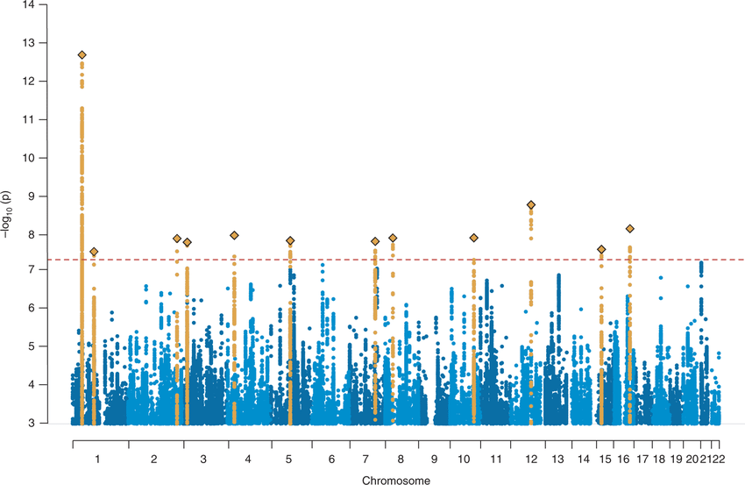
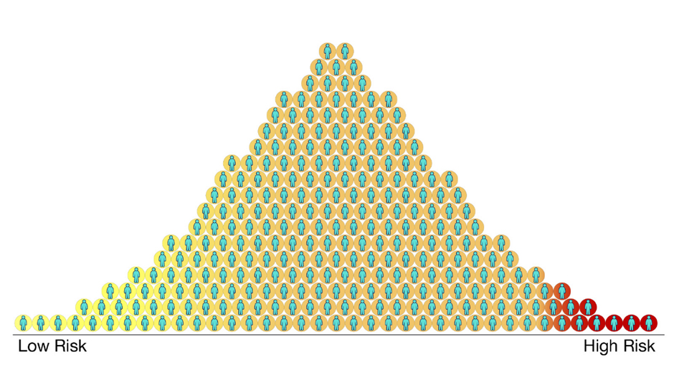
INTRODUCTION TO POLYGENIC RISK SCORE
Significance SNPs
→ Weighting based on effect size
→ Calculate Polygenic Risk Score

Slide 3
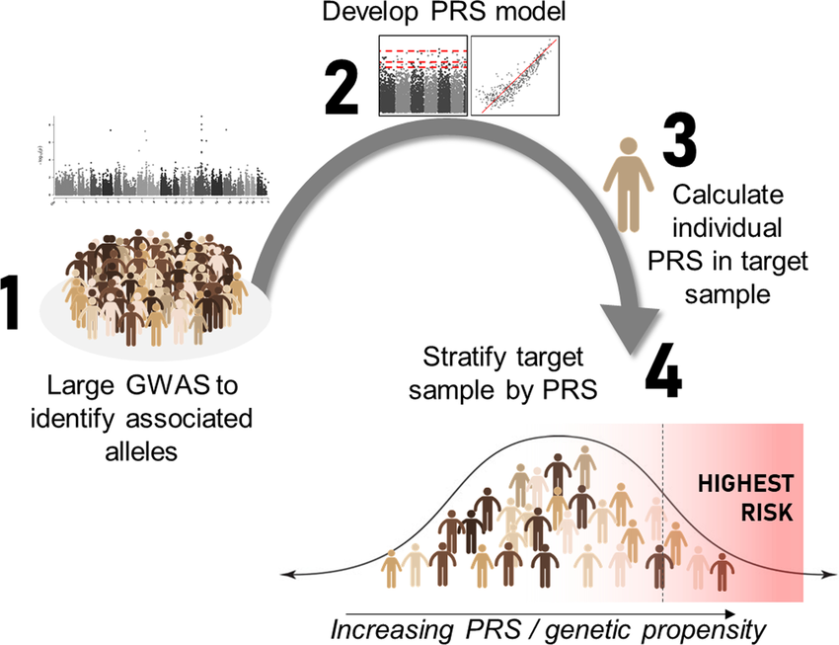
INTRODUCTION TO POLYGENIC RISK SCORE
Converting Genome-Wide Association Study (GWAS) results into a Polygenic Risk Score (PRS) involves using the genetic information gathered from the GWAS to calculate a personalized risk score for individuals.
GWAS Analysis
Selection of Relevant SNPs
Assigning Weights
Summing Weighted SNP Values
Interpreting the Score

Slide 4
INTRODUCTION TO POLYGENIC RISK SCORE
Polygene
A polygene is a member of a group of non-epistatic genes that interact additively to influence a phenotypic trait, thus contributing to multiple-gene inheritance (polygenic inheritance, multigenic inheritance, quantitative inheritance), a type of non-Mendelian inheritance, as opposed to single-gene inheritance, which is the core notion of Mendelian inheritance
Polygenetic Risk Score (PRS)
A polygenic risk score estimates the genetic risk of an individual for some disease or trait, calculated by aggregating the effect of many common variants associated with the condition.

Slide 5
DATASETS
PRS analyses can be characterized by the two key input data sets that they require:
(i) Base data (GWAS), consisting of summary statistics of genotype-phenotype associations at genetic variants (hereafter SNPs) genome-wide, typically made availabe online in text format by the investigators who performed the GWAS
(ii) Target data Consisting of genotypes, and usually also phenotypes, in individuals from a sample to which the researchers performing the PRS analysis have access (often not publicly available), which should be independent of the GWAS sample.

Slide 6
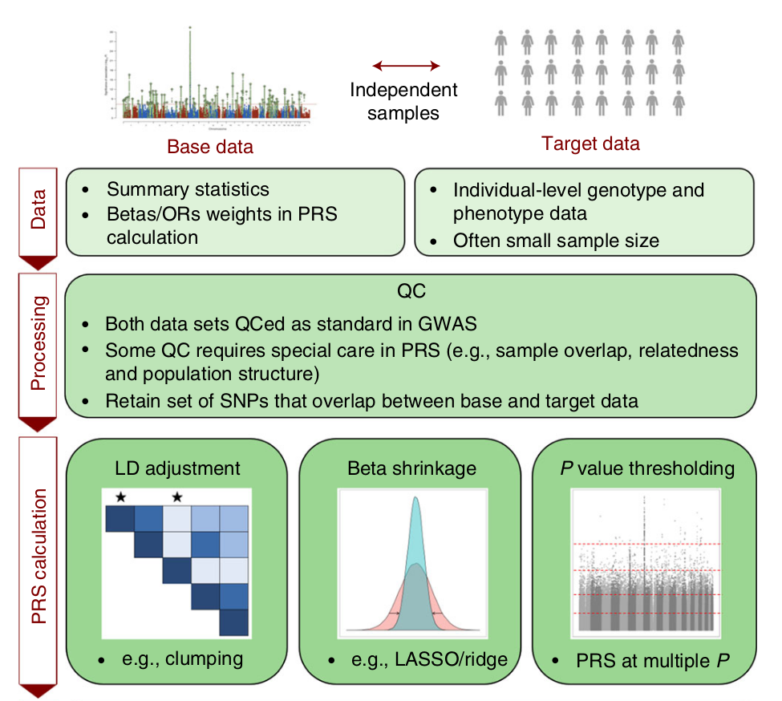
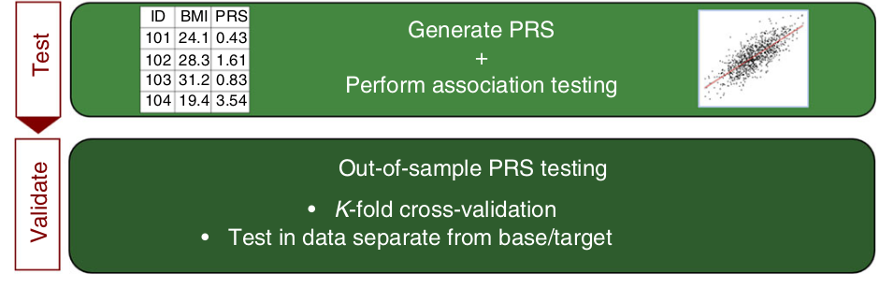
WORKFLOW

Slide 7
INTRODUCTION TO POLYGENIC RISK SCORE
Application
Disease Risk Prediction: PRS helps estimate an individual's risk for developing complex diseases like heart disease, diabetes, or cancer. It provides insights into the genetic component of these diseases and can help identify individuals who might benefit from early intervention or more vigilant screening.
Pharmacogenetics: PRS can predict how an individual might respond to specific medications based on their genetic makeup. This personalized approach to drug treatment can help tailor medication choices and dosages to achieve better outcomes and minimize adverse reactions.
Research and Clinical Trials: PRS is used in research to stratify individuals into different risk groups, helping to identify subpopulations that might be more responsive to certain interventions. This can improve the efficiency and efficacy of clinical trials.

Slide 8
INTERPRET THE RESULT
The final outcome of a Polygenic Risk Score (PRS) is a numerical value that
Represents an individual's genetic predisposition or susceptibility to a specific trait or disease based on their genetic makeup.
This score is calculated by considering a combination of multiple genetic variants, often Single Nucleotide Polymorphisms (SNPs), and their associated effect sizes.

Slide 9
REFFERENCE
https://choishingwan.github.io/PRS-Tutorial/

